Slide 1

Network Layer II: roadmap
Dynamic Host Configuration Protocol (DHCP)
Network Address Translation (NAT)
Forwarding - what’s inside a router
input ports, switching, output ports
buffer management, scheduling

Slide 2

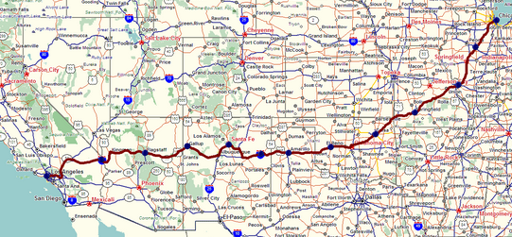
Two key network-layer functions
network-layer functions:
forwarding: move packets from a router’s input link to appropriate router output link
analogy: taking a trip
forwarding: process of getting through single interchange
routing: process of planning trip from source to destination
routing: determine route taken by packets from source to destination
routing algorithms
转发:将数据包从路由器的输入链路移动到相应的路由器输出链路
路由:确定数据包从源到目的所经过的路由
forwarding
routing

Slide 3
Interplay between routing and forwarding
routing algorithm determines
end-end path through network
routing algorithm
local forwarding table
header value
output link
forwarding table determines
local forwarding at this router
0100
0101
0111
1001
3
2
2
1
路由算法确定了通过网络的端到端路径
转发表决定了本路由器的本地转发
value in arriving
packet’s header
0111
1
3
2

Slide 4
Router architecture overview
通用路由器架构的高级视图
high-level view of generic router architecture:
路由管理控制平面(软件)
在毫秒时间帧内运行
routing, management
control plane (software)
operates in millisecond
time frame
routing
processor
forwarding data plane (hardware) operates in nanosecond timeframe
转发数据平面(硬件)以纳秒的时间帧运行
high-speed
switching
fabric
router input ports
router output ports

Slide 5
Input port functions
lookup,
forwarding
queueing
line
termination
link
layer
protocol
(receive)
switch
fabric
physical layer:
bit-level reception
分散的切换:
使用报头字段值，使用输入端口内存中的转发表查找输出端口(“匹配+动作”)
基于目的的转发:只基于目的IP地址转发(传统)输入端口排队:如果数据报到达交换机的速度比转发速率快
decentralized switching:
using header field values, lookup output port using forwarding table in input port memory (“match plus action”)
destination-based forwarding: forward based only on destination IP address (traditional)
input port queuing: if datagrams arrive faster than forwarding rate into switch fabric
link layer:
e.g., Ethernet

Slide 6
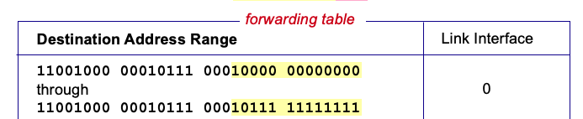
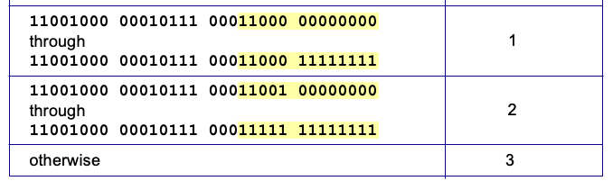
Destination-based forwarding
Q: but what happens if ranges don’t divide up so nicely?

Slide 7
Longest prefix matching
longest prefix match
when looking for forwarding table entry for given destination address, use longest address prefix that matches destination address. (most specific match)
Prefix
11001000 00010111 00010
11001000 00010111 00011000
11001000 00010111 00011
otherwise
Link interface
0
1
2
3
***
********
********
***
********
examples:
11001000 00010111 00010110 10100001
which interface?
11001000 00010111 00011000 10101010
which interface?

Slide 8
Longest prefix matching
longest prefix match
when looking for forwarding table entry for given destination address, use longest address prefix that matches destination address.
Destination Address Range
11001000 00010111 00010
11001000 00010111 00011000
11001000 00010111 00011
otherwise
Link interface
0
1
2
3
***
********
********
match!
***
********
examples:
11001000 00010111 00010110 10100001
which interface?
11001000 00010111 00011000 10101010
which interface?

Slide 9
Longest prefix matching
longest prefix match
when looking for forwarding table entry for given destination address, use longest address prefix that matches destination address.
Destination Address Range
11001000 00010111 00010
11001000 00010111 00011000
11001000 00010111 00011
otherwise
Link interface
0
1
2
3
***
********
********
***
********
match!
examples:
11001000 00010111 00010110 10100001
which interface?
11001000 00010111 00011000 10101010
which interface?

Slide 10
Longest prefix matching
longest prefix match
when looking for forwarding table entry for given destination address, use longest address prefix that matches destination address.
Destination Address Range
11001000 00010111 00010
11001000 00010111 00011000
11001000 00010111 00011
otherwise
Link interface
0
1
2
3
***
********
********
***
********
match!
examples:
11001000 00010111 00010110 10100001
which interface?
11001000 00010111 00011000 10101010
which interface?

Slide 11
Switching fabrics
transfer packets from input ports to appropriate output ports
switching rate: rate at which packets can be transfer from inputs to outputs
将数据包从输入端口传输到相应的输出端口
交换速率:数据包从输入端传输到输出端的速率
三种主要类型的开关织物:
three major types of switching fabrics:
memory
memory
bus
interconnection
network

Slide 12
Input port queuing
如果交换机结构比输入端口的组合速度慢—输入队列可能出现>排队．
由于输入缓冲区溢出导致排队延迟和丢失!
head -of- line (HOL)阻塞:在队列前面排队的数据报阻止队列中的其他数据报向前移动
If switch fabric slower than input ports combined -> queueing may occur at input queues
queueing delay and loss due to input buffer overflow!
Head-of-the-Line (HOL) blocking: queued datagram at front of queue prevents others in queue from moving forward
switch
fabric
switch
fabric
output port contention: only one red datagram can be transferred. lower red packet is blocked
one packet time later: green packet experiences HOL blocking

Slide 13
Output port queuing
datagram
buffer
queueing
switch
fabric
(rate: NR)
link
layer
protocol
(send)
line
termination
R
当从fabric到达的数据报比链路传输速率快时，需要缓冲。
调度规程在以下方面进行选择的排队数据报传输
优先调度——谁能获得最好的性能，网络中立性
Buffering required when datagrams arrive from fabric faster than link transmission rate. Drop policy: which datagrams to drop if no free buffers?
Datagrams can be lost due to congestion, lack of buffers
Scheduling discipline chooses among queued datagrams for transmission
Priority scheduling – who gets best performance, network neutrality

Slide 14
Packet Scheduling: FCFS
packet scheduling: deciding which packet to send next on link
first come, first served
priority
round robin
FCFS:
Packets transmitted in order of arrival
also known as: First-in-first-out (FIFO)
Simple implementation
No flow prioritization
No fairness, no isolation
Work-conserving scheduler
分组调度:决定链路上下一个发送哪个分组
先到先得
轮循
Abstraction: queue
按到达顺序传送的包
也被称为:先进先出(FIFO)
简单的实现
没有流优先级
没有公平，就没有孤立
Work-conserving调度器
R
packet
departures
packet
arrivals
queue
(waiting area)
link
(server)

Slide 15
Scheduling policies: priority
Priority scheduling:
arriving traffic classified, into priority classes
any header fields can be used for classification
high priority queue
arrivals
classify
link
departures
优先级调度:
到达的交通按优先级分类
任何报头字段都可以用于分类
从已缓冲的最高优先级队列发送数据包
优先级中的FCFS
low priority queue
2
send packet from highest priority queue that has buffered packets
FCFS within priority class
1
3
4
5
arrivals
packet in service
1
3
2
4
5
departures
1
3
2
4
5

Slide 16
Scheduling policies: round robin
RR (Round Robin)调度:
对到达的流量进行分类，按类排队
任何报头字段都可以用于分类
Round Robin (RR) scheduling:
arriving traffic classified, queued by class
any header fields can be used for classification
server cyclically, repeatedly scans class queues, sending one complete packet from each class (if available) in turn
R
classify
arrivals
link
departures

Slide 17
Thank You!

